Slide 1
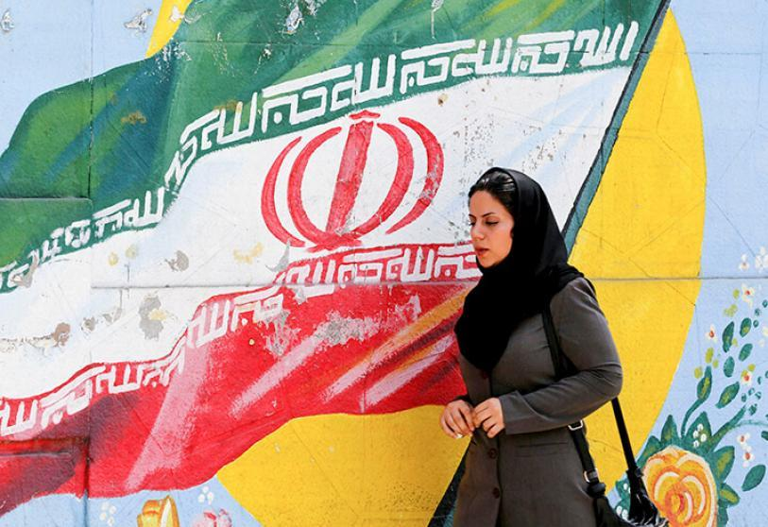
Current Events Discussion: Iran

Slide 2
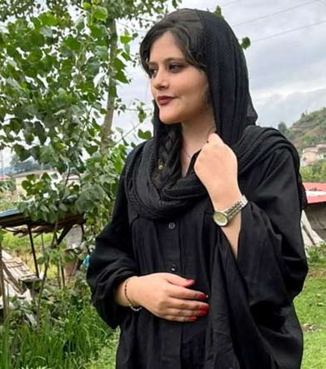
Who is Mahsa Amini?
22 year old Iranian woman
Arrested on an accusation of violating the hijab law.
Died three days after her detention while in the custody of the “morality police”
Iran’s security forces issued a statement saying that Ms. Amini collapsed from a heart attack at the detention center while receiving “training on hijab rules.”

Slide 3
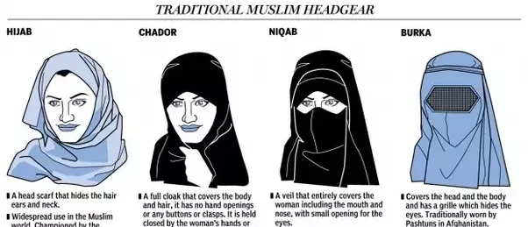
Hijab Law in Iran
All women are required to wear loose-fitting clothing and a headscarf in public.
The law came into effect in 1981, after the Islamic revolution.
In 1983, The Islamic Consultative Assembly decided that women who do not cover their hair in public will be punished with 74 lashes.
Since 1995, unveiled women can also be imprisoned for up to 60 days.

Slide 4

Restrictions Tighten
On 23 February 2018, Iranian Police released an official statement saying that any women found protesting Iran's compulsory veiling code would be charged with "inciting corruption and prostitution," which carries a maximum sentence of 10 years in prison.
Women are also subject to lashing if found in violation of the laws.

Slide 5
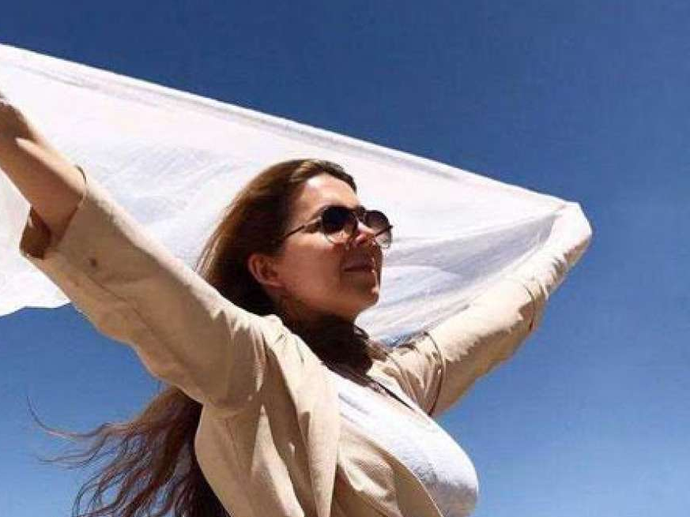
White Wednesday
Campaign started in May 2017 for women who willingly wear the veil, but who remain opposed to the idea of imposing it on others.
Many veiled women in find the compulsory imposition of the veil to be an insult.
By taking videos of themselves wearing white, these women can also show their disagreement with compulsion.

Slide 6
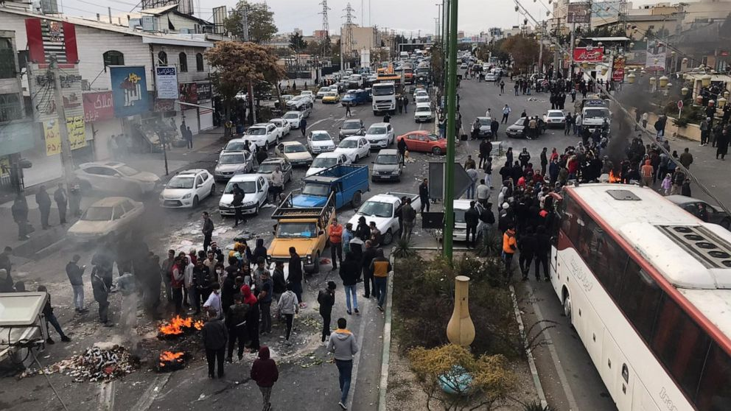
Bloody November (2019)
Currently, extraordinary scenes of dissent call for an end the Islamic Republic
The protests have become one of the most visible challenges to the government since the last wave of unrest in 2019, which was met with a deadly response. (1500 killed)

Slide 7
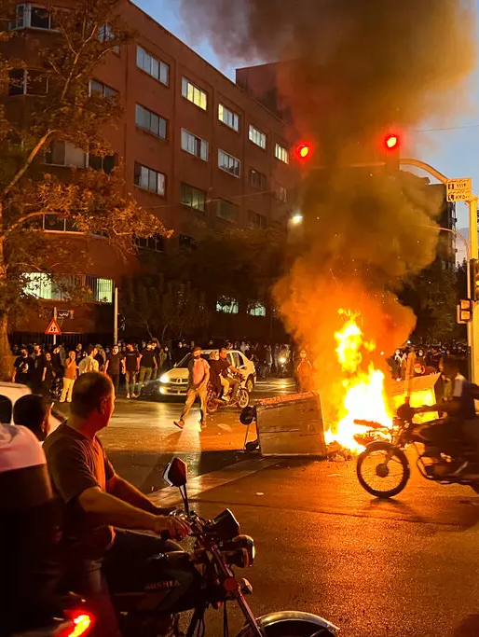
Authorities are answering with practiced force.
Security forces have fired on protesters with gunshots and water cannons and beat them with batons. Cellphone and internet usage has been dramatically restricted.’
In the northwestern province of Kurdistan alone, at least 17 protesters have been killed, according to the Kurdistan Human Rights Network, which has posted names and photos of victims online.
At least 733 people have been injured and more than 600 people arrested across the Kurdish province.

Slide 8
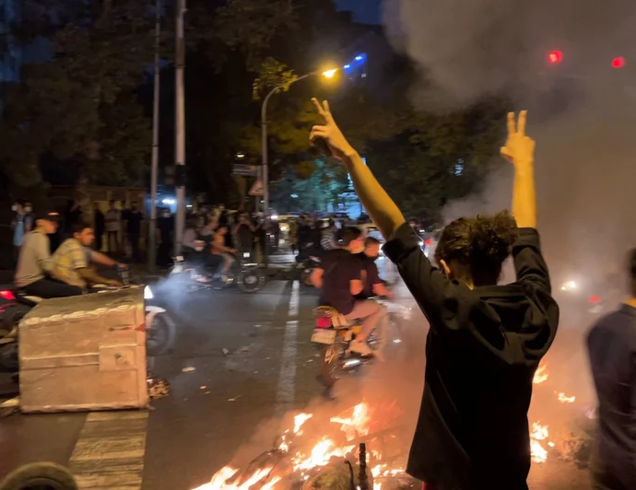
Ongoing Crisis
The protests have showed no signs of easing.
On Thursday, the Revolutionary Guards, Iran’s powerful security force, issued a statement describing what was occurring as sedition and saying that protesters must be crushed to teach other people a lesson.
In Tehran, power was cut at night, casting the streets into total darkness
Continued internet blackout

Slide 9
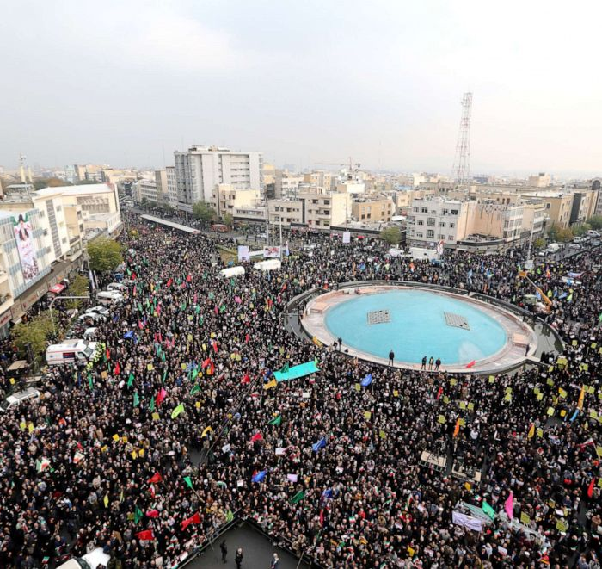
Roots of Civil Unrest
Iran’s economy has been at rock bottom for years.
U.S.-led sanctions in response to the country’s nuclear and missile programs have made it much harder for Iran to sell its oil and cut access to the global financial system.
Corruption and economic mismanagement are rife.
Iranians have long been subject to ever-rising inflation, food shortages and supply disruptions, and a scarcity of jobs.

Slide 10
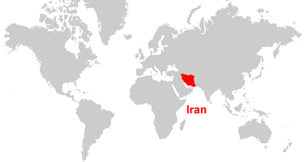
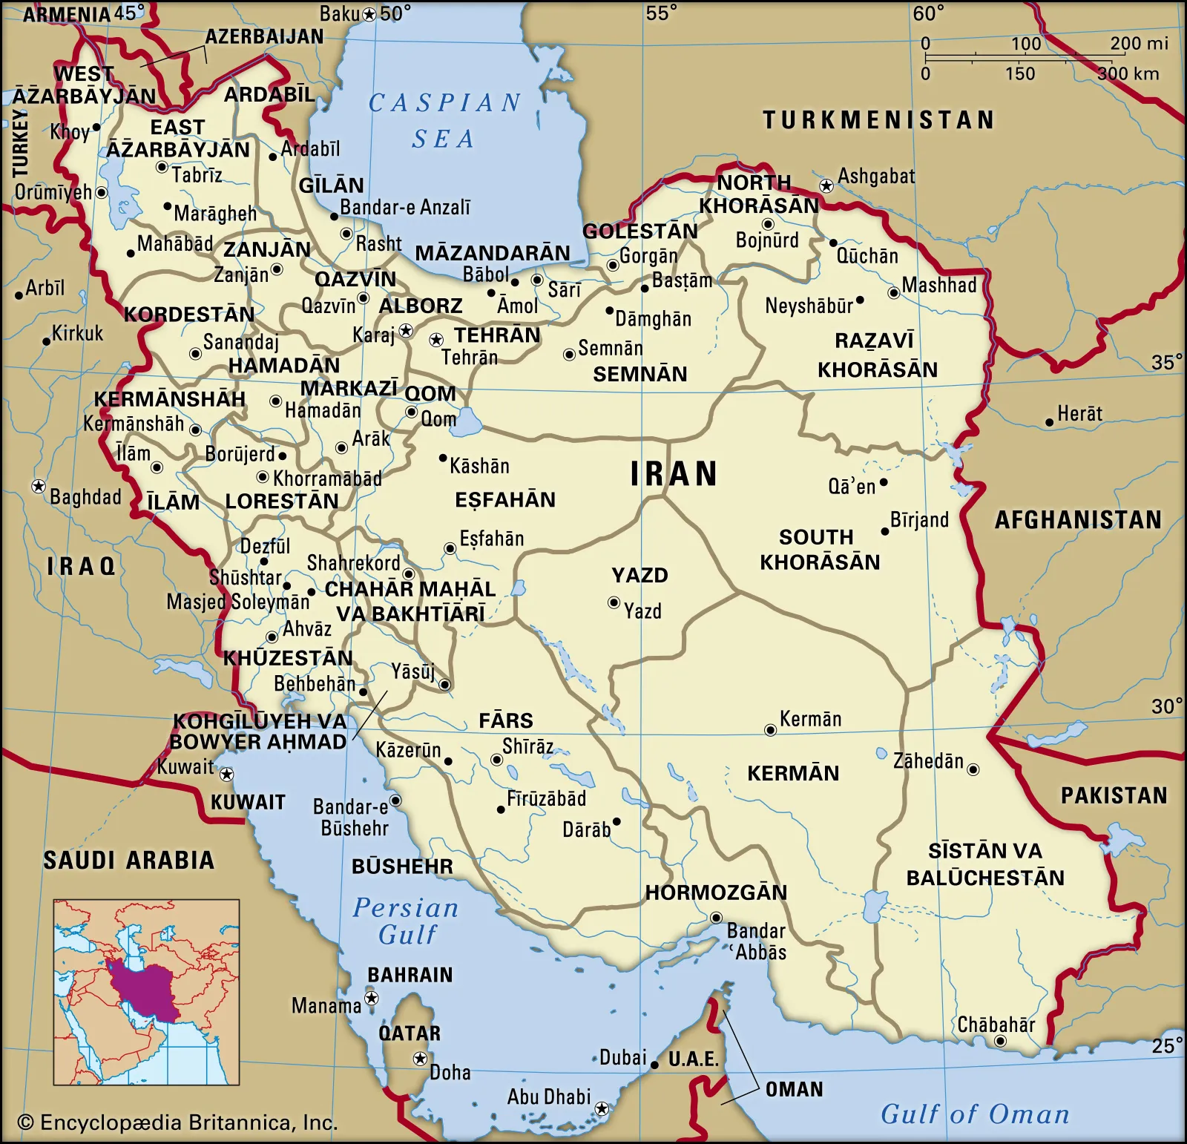
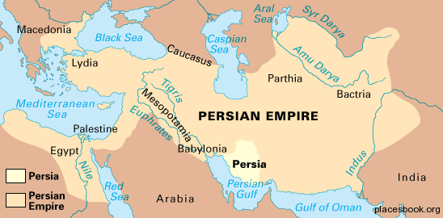
Where in the World is Iran?

Slide 11
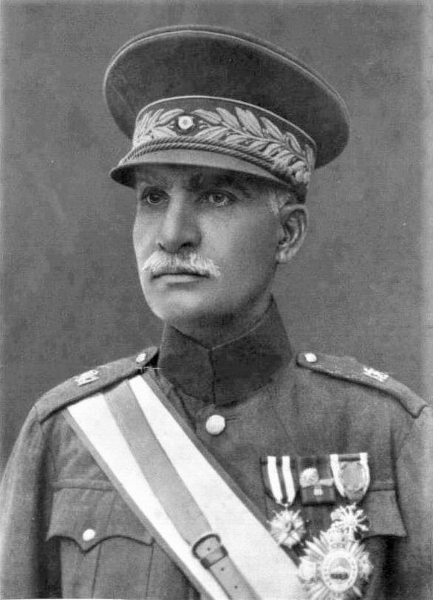
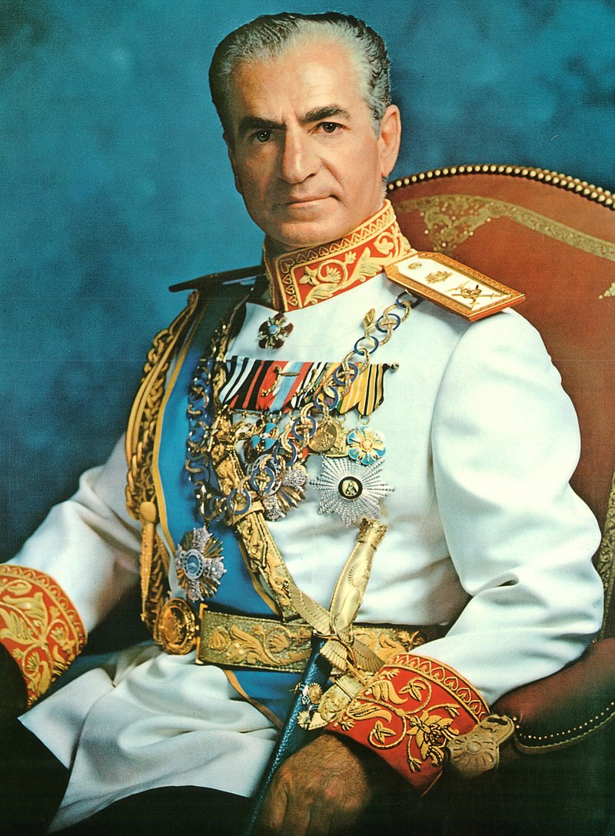
World War II Era
Great Britain, USA, USSR – Allies (the enemy of my enemy is my friend)
GOAL:
Protect oil of the Middle East from Nazis
Reza Shah (1925-1941) considered Nazi sympathizer. Removed as leader of Iran by allies. His son, Mohammed Reza Shah was instated and reigned until the Revolution (1941-1979)
Banned veiling in 1936
“oil is the lifeblood of the armies of WWII”
Cutting off Japan’s oil supply is what caused the attack on pearl Harbor
1940 – 63% of world’s oil from the USA only 5% from ME

Slide 12
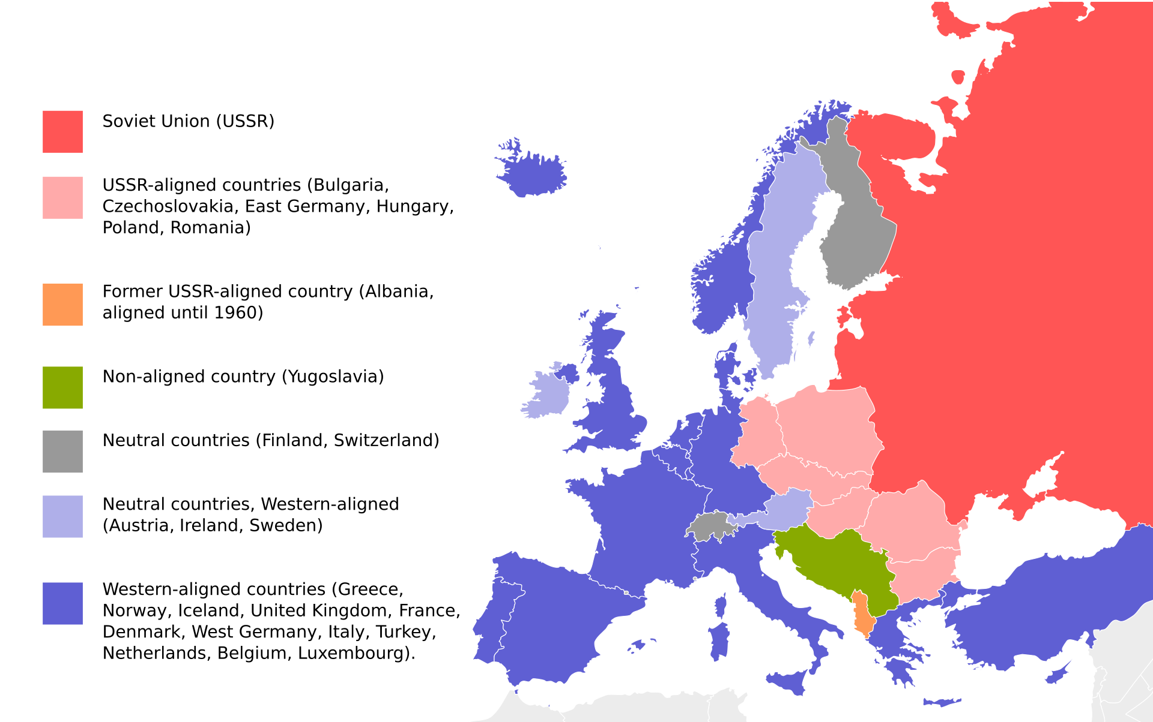
Post-War Splits

Slide 13
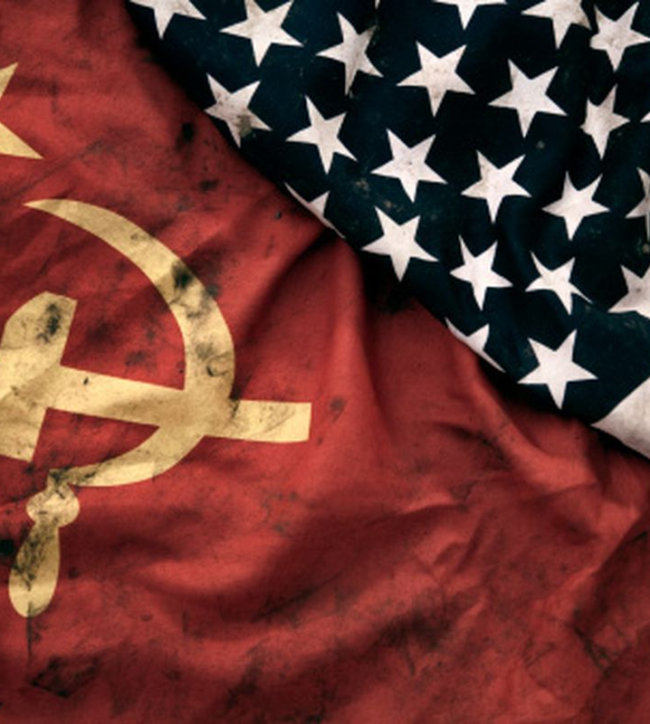
Cold War – 1948 – 1991…?
United States | Vs. | Soviet Union
-spread democracy/capitalism and stop the spread of communism | Overall Goal | -spread communism and stop the spread of capitalism
-gain allies and access to oil reserves | Goal in the Middle East | -gain allies and access to oil reserves

Slide 14
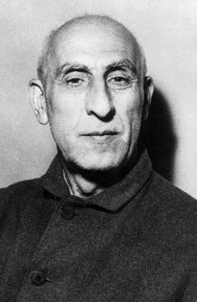
Fears over Iran
Countries that recently gained independence were feared to side with Soviet Union
Iran
Elected Prime Minister (Mossadegh) in 1951
Nationalized oil
Legitimate fear or ‘excuse’ to get involved?

Slide 15
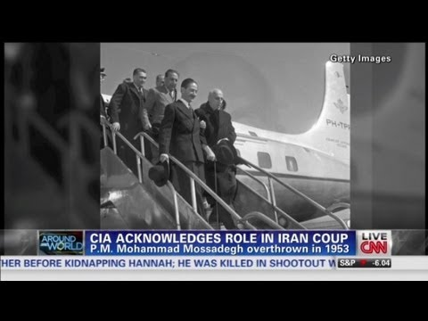
1953 Iranian Coup
Britain & US CIA involvement
Embargo on trade caused economic troubles
“Operation Ajax”
False reports were planted in newspapers
Violence occurred in the streets of Iran
Shah overthrew Mossadegh
Received aid & military arms from US & Britain

Slide 16
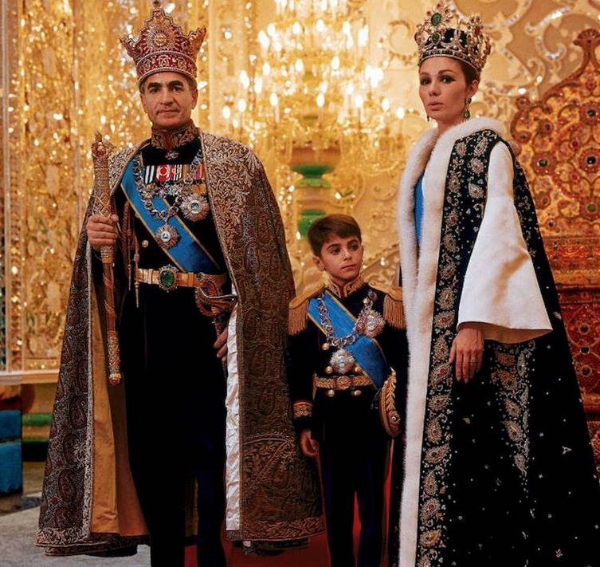
Shah’s Rule of Iran
Contradictory?
Liked many aspects of “modernism”
Supported women’s rights
Claimed to redistribute land from wealthy to farmers
Receptive to Western policy ideas
Very authoritarian
Islamic clergy’s power slowly taken away
Created a one-party system
Corruption

Slide 17
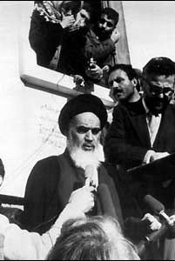
1979: Islamic Revolution in Iran
Ideology:
Saw Western culture as a ‘plague’
Traditional Islam was the only ‘liberator’
Ayatollah Khomeini
Began leading opposition against Shah in 1963
Believed everyone & everything needed supervision by Islamic leaders, to ensure sticking to the laws of the faith

Slide 18
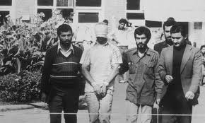
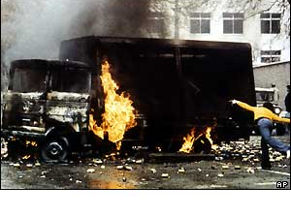
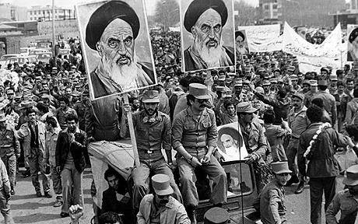
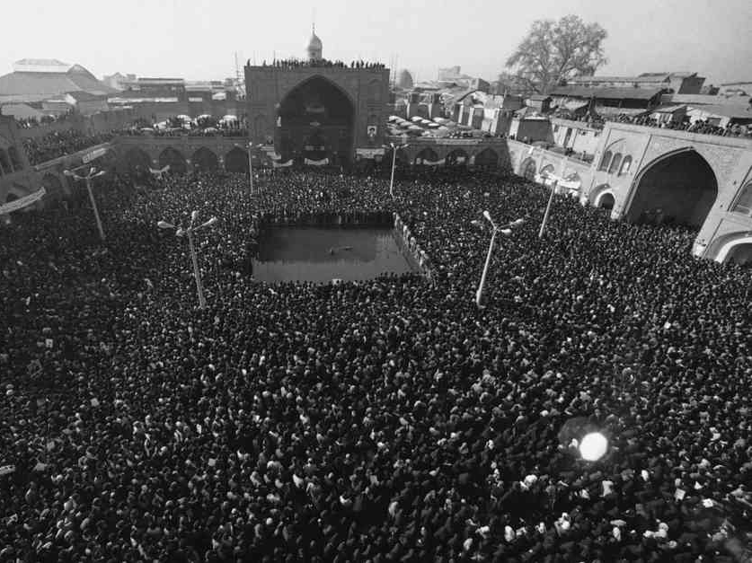
Images of Revolution Nightly News--Primary Source

Slide 19
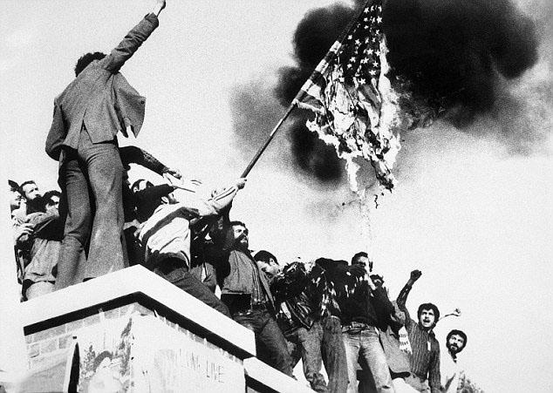
Islamic Revolution: Groups Involved
Political Groups
Marxist
Focused on social-class issues
Islamic Groups
Followers of Khomeini
Focused on cultural issues

Slide 20
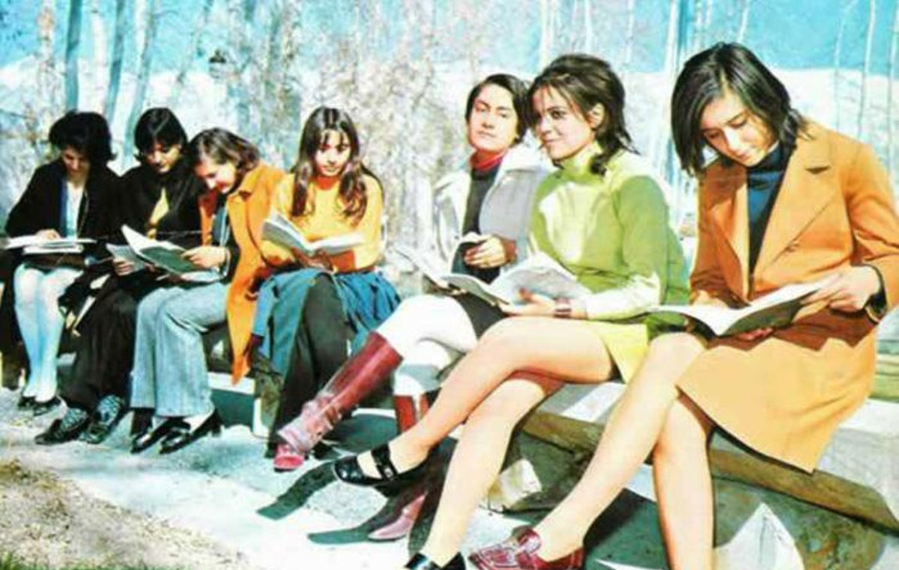
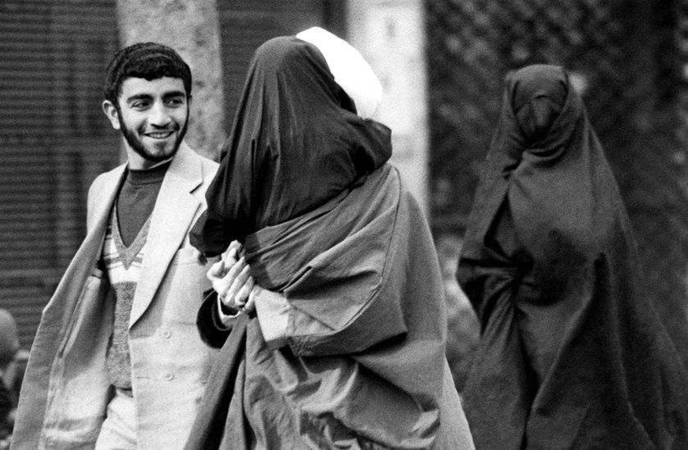
Results of Revolution
Ties between Iran & West completely severed
Shah’s Westernization reversed
Women were ordered to wear head coverings and full body cloaks
Gangs of religious zealots roamed the streets enforcing new laws
Ayatollah rule not what was expected

Slide 21
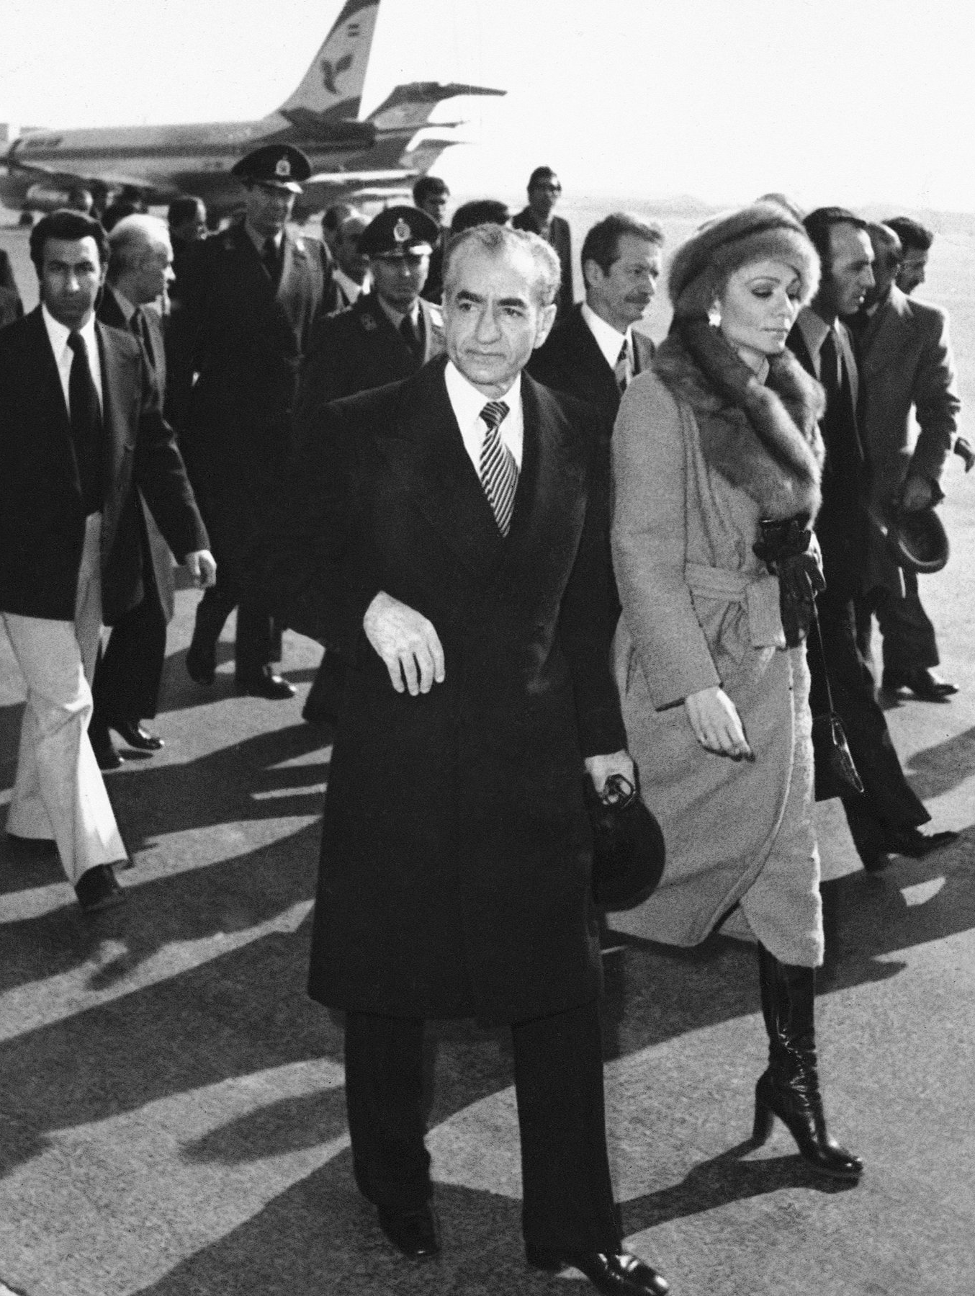
Results of Revolution
Some revolutionaries now seen as enemies
Even people who supported the revolution but not Kohmeini were imprisoned, beaten & killed
Shah & wife left Iran in January, 1979
October 1979: Shah comes to US for cancer treatment
Hostage situation, lead by student group
Failed rescue attempt killed 8 Americans
Shah died in July 1980, hostages not released until January 1981
Women in the Revolution

